Slide 1
Algorithm

Slide 2
What is a task?
TASK
N different labels
K different samples in one label
N way
K shot
Support Set
Query Set

Slide 3
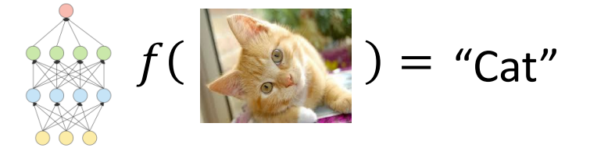
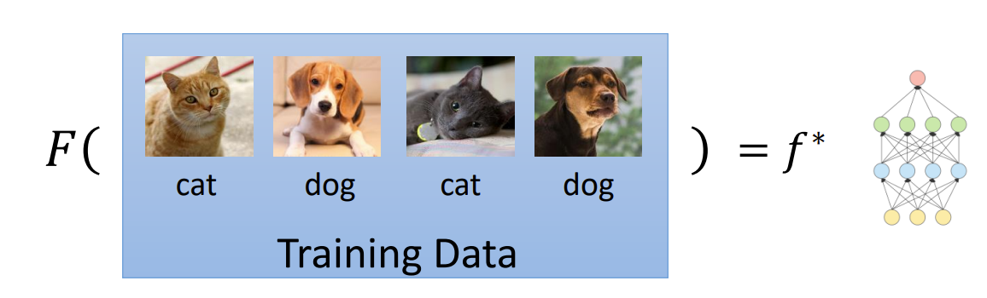
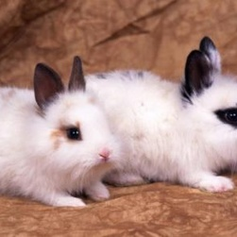
Meta Learning
Machine Learning
Finding a function f according to the given dataset
Finding a function F that can quickly adapt to different test tasks
Meta Learning

Slide 4
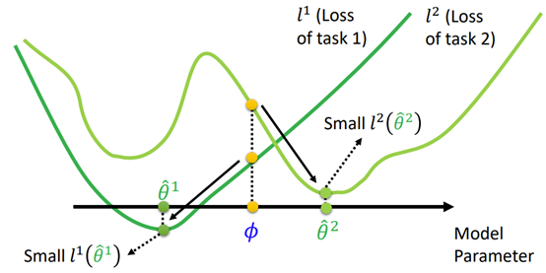

Algorithm ----MAML
Goal: To learn parameters that can rapidly converge to global minimum of a new test task

Slide 5
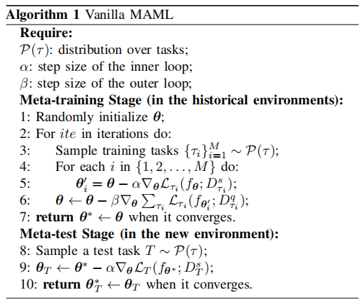
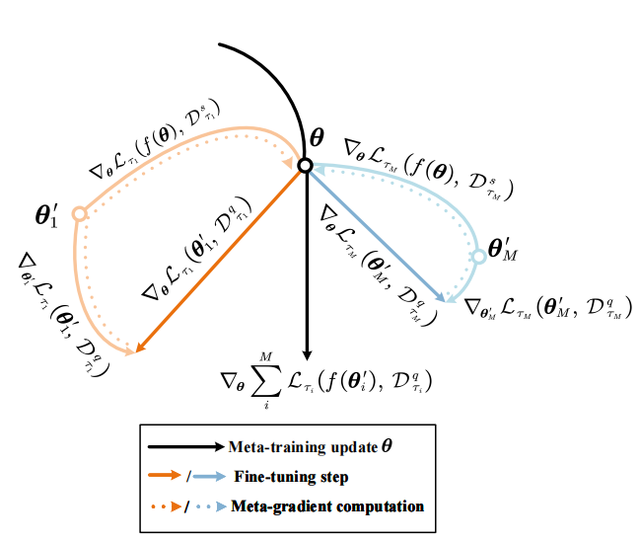
Algorithm ----MAML
Outer
inner
C. Finn, P. Abbeel, and S. Levine, “Model-agnostic meta-learning for fast adaptation of deep networks,” in Proc. Int. Conf. Mach. Learn., 2017, pp. 1126–1135.

